Slide 1
TEEN PHONE ADDICTION
Group 3: Clara Alvarez, Eric Doppert,
Keerthanaa Ellur, & Angel Nguyen
Notes:
Eric

Slide 2
TABLE OF CONTENTS
01
04
02
05
03
06
THE DATA
RECOMMENDATIONS
LIMITATIONS
& FUTURE WORKS
METHODOLOGY
RESULTS
CONCLUSIONS
Notes:
Eric

Slide 3
01
THE
DATA
Notes:
Clara

Slide 4
OUR DATA
Kaggle: Teen Phone Addiction
Survey of ~3,000 students (ages 12–18)
Originally 25 variables
Name and location excluded
Data cleaned in Python (Google Colab)
No missing values
Converted categorical variables into dummy variables
Turned into 42 variables
  Demographics
  Smartphone Habits
  Activities
Notes:
Clara

Slide 5
DATA DICTIONARY
Variable Name | Description | Type
Age | Age in years | Integer
Gender | Gender | Categorical
School_Grade | Current grade in school | Ordinal Integer
Daily_Usage_Hours | Avg daily phone usage (hours) | Float
Sleep_Hours | Avg daily sleep duration (hours) | Float
Academic_Performance | % Grade out of 100 | Integer
Social_Interactions | Frequency/quality of in-person social interactions | Ordinal Integer
Notes:
Clara

Slide 6
DATA DICTIONARY CONT.
Exercise_Hours | Weekly exercise duration (hours) | Float
Anxiety_Level | Self-reported anxiety (0–10 scale) | Ordinal Integer
Depression_Level | Self-reported depression (0–10 scale) | Ordinal Integer
Self_Esteem | Self-esteem score (0–10 scale) | Ordinal Integer
Parental_Control | Level of parental monitoring | Ordinal Integer
Screen_Time_Before_Bed | Phone use before sleep (hours) | Float
Phone_Checks_Per_Day | Number of daily phone checks | Integer
Apps_Used_Daily | Number of distinct apps used daily | Integer
Notes:
Clara

Slide 7
DATA DICTIONARY CONT.
Time_on_Social_Media | Daily time spent on social media (hours) | Float
Time_on_Gaming | Daily gaming time (hours) | Float
Time_on_Education | Daily time on educational apps (hours) | Float
Phone_Usage_Purpose | The primary purpose of phone use | Categorical
Family_Communication | Frequency of family communication via phone | Ordinal Integer
Weekend_Usage_Hours | Average daily phone use on weekends (hours) | Float
Addiction_Level | Smartphone addiction index (0-10) | Float/Ordinal Integer
Notes:
Clara

Slide 8
02
METHODOLOGY

Slide 9
RESEARCH QUESTIONS
1. CLARA
2. ERIC
What patterns of smartphone usage exist among teenagers, and how do these usage profiles differ in academic performance and mental health outcomes?
Which combinations of smartphone usage behaviors best predict lower academic performance?
3. KEERTHANA
4. ANGEL
How does the relationship between smartphone use (in time and habits) and academic performance and mental health differ across School_Grade?
What profiles of smartphone usage among teenagers are most predictive of negative academic and mental health outcomes?
Notes:
Everyone says their own question

Slide 10
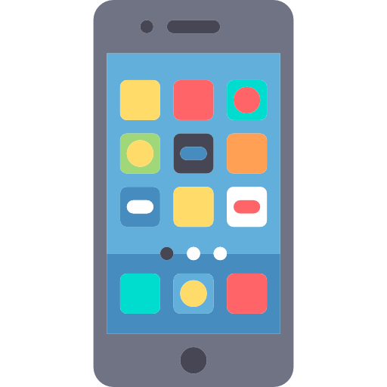
QUESTION 1
What patterns of smartphone usage exist among teenagers, and how do these usage profiles differ in academic performance and mental health outcomes?
Exploratory Analysis: Used clustering to identify distinct usage patterns
Goal: Uncover meaningful groups within the data
Identified profiles of teen smartphone use
Compared these profiles across academic performance and mental health outcomes
Notes:
Clara

Slide 11
QUESTION 2
Which combinations of smartphone usage behaviors best predict lower academic performance?
Conducted pairwise correlation analysis to identify relationships between variables
Focused on Addiction Level and Academic Performance
Statistical Methods Used
  One-Way ANOVA: Compare academic performance across addiction groups (assumes normal distribution)
  Kruskal-Wallis H-Test: Test for median differences when data is not normal
  Dunn-Bonferroni Post-Hoc Test: Pairwise comparisons of group means after ANOVA or Kruskal-Wallis
  Pearson Correlation Coefficient: Measures strength and direction of linear relationships
Goal: Identify smartphone usage combinations associated with lower academic outcomes
Notes:
Eric

Slide 12

QUESTION 3
How does the relationship between smartphone use (in time and habits) and academic performance and mental health differ across School_Grade?
Dependent Variables (Outcomes):
  Academic Performance (0–100)
  Mental Health Risk (reversed index; higher = worse)
Independent Variables (Predictors):
  Total daily hours, bedtime screen time, number of apps used, phone checks
  Time on social media, gaming, and educational apps
  Weekend hours, self-reported addiction score
  Grade-Level Interactions: examined shifts in effects across developmental stages
Goal: Understand how smartphone use affects outcomes differently at each grade level
  Identify age or grade specific patterns to inform interventions
Notes:
Keerthanaa

Slide 13
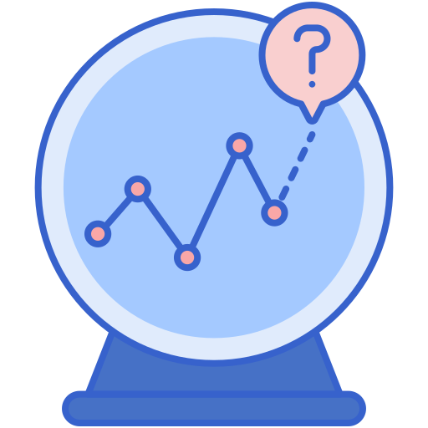
QUESTION 4
What profiles of smartphone usage among teenagers are most predictive of negative academic and mental health outcomes?
Dependent Variables: Academic Performance & Depression Level
Independent Variables: daily usage, bedtime screen time, phone checks, apps used, time on social media, gaming, educational apps
Methods:
  Regression Models: examine individual predictors
  K-means Clustering: identify behavioral profiles
  Elbow Method: optimized cluster number → 3 clusters
Cluster Profiles Identified: Light/Moderate, Heavy, and Educational/Balanced Users
Goal: Examine whether smartphone behavior patterns can explain differences in academic and mental health outcomes
Notes:
Angel
“Now I’ll walk through our fourth research question, which focuses on whether certain profiles of smartphone behavior are linked to negative academic or mental-health outcomes.
For this section, we combined both regression models and clustering. Our goal was to look beyond individual variables and instead understand full behavior patterns.
We focused on daily usage, bedtime screen time, phone checks, and time spent on different types of apps—like social media, gaming, and educational tools. After testing several models, we used the elbow method and identified three main clusters: light or moderate users, heavy users, and educational or balanced users.
Our focus here is that we wanted to see whether behavioral patterns, rather than isolated habits, could better predict lower grades or worse mental health.”
I will now pass it back to Clara

Slide 14
RESULTS
03

Slide 15
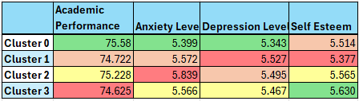
CLUSTERING METHOD OVERVIEW
Data Preparation & Method
  Removed non-usage variables (demographics, outcomes, well-being)
  Retained smartphone usage features; dummy-coded “Phone_Usage_Purpose”
  Tested k = 1–10 clusters using the elbow method → selected 4 clusters
  Applied K-means (k = 4)
Result: Identified four distinct smartphone usage profiles
See Figure 6 for full cluster feature values (discussed next)
Notes:
Clara

Slide 16
PROFILE INSIGHTS
Cluster 0 – Gaming-Focused
Cluster 1 – Social Media-Focused
Usage: ~5.1 hrs/day; ~6.0 weekend
Outcomes: Best academics (75.6), lowest anxiety/depression
Takeaway: Gaming used as healthy recreation; strong emotional stability
Usage: ~4.87 hrs/day; ~6.03 weekend
Outcomes: Lowest academics (68.2), highest depression
Takeaway: High social media tied to stress, comparison, compulsive use
Cluster 2 – Education-Focused
Cluster 3 – Mixed/General
Usage: ~4.94 hrs/day; ~6.05 weekend
Outcomes: High academics (74.9) but highest anxiety
Takeaway: Strong academic engagement but emotional cost from pressure
Usage: ~5.10 hrs/day; balanced usage
Outcomes: Moderate academics, highest self-esteem
Takeaway: Variety supports emotional regulation; protective pattern overall
Notes:
Clara

Slide 17
PAIRWISE CORRELATION ANALYSIS
Addiction Levels Categorized:
  Low (0–3.5)
  Medium (3.6–6.5)
  High (6.6–10)
One-Way ANOVA: F = 0.707, p = 0.493 → no significant difference
Kruskal-Wallis & Dunn-Bonferroni: confirmed no significant differences
Conclusion: Addiction levels do not significantly affect academic performance
Notes:
Eric

Slide 18

PEARSON CORRELATION COEFFICIENT
Positive correlations indicate behaviors that increase addiction risk (more phone use, gaming, apps, social media)
Negative correlations show behaviors protective against addiction (more sleep, education time, balanced weekend use)
Positive Correlations
  Daily Usage Hours: 0.60
  Apps Used Daily: 0.32
  Time on Social Media: 0.31
  Time on Gaming: 0.27
  Phone Checks per Day: 0.25
Negative Correlations
  Weekend-Weekday Usage Difference: -0.43
  Share of Education Time: -0.34
  Sleep Hours: -0.22
Notes:
Eric

Slide 19
KEY TAKEAWAYS
Increase addiction → more phone use, social media, gaming, apps
Decrease addiction → more sleep, education, balanced usage
Despite these behavioral changes, academic performance, anxiety, and depression show near zero relationship with addiction
Indicates that addiction level reflects behavioral patterns, not direct academic outcomes
Supports the idea that usage context matters
  Some heavy phone behaviors (e.g., gaming) may not harm academics
Healthy habits and balanced usage should be encouraged
Notes:
Eric

Slide 20
ACADEMICS & MENTAL HEALTH
ACADEMICS
MENTAL HEALTH
R² = .024 → minimal variance explained
Leads into grade-specific findings
7th Grade: Early-Grade Benefit
  Moderate use of educational apps → higher scores
  Likely supported by parental structure and guided learning
8th-9th Grade: Transition Pressure
  Many apps / long weekend hours → modest dips
  Reflects early struggles balancing leisure and coursework
12th Grade — Senior-Year Fatigue
  Heavy educational-app time + high addiction → lower performance
  Suggests digital overload and burnout during high-stakes year
R² = .367 → more variance explained than academics
Mental health is shaped by addiction patterns, not total hours
Younger students show stronger reactions to compulsive use
  Most pronounced in 7th, 9th, and 10th grades, which appear to be key developmental pressure points
Addiction Level = Most Powerful Predictor
  β = 0.42, p < .001
  Higher addiction → significantly higher mental-health risk
  Strongest in grades 7, 9, and 10
Other Factors
  Gaming / total hours → small negative effects
  Structured leisure may relieve stress
  Exercise → protective, reduces risk
Notes:
Keerthanaa

Slide 21
VARIOUS ANALYSES
Regression Analyses
  Examined how individual smartphone behaviors relate to academic performance and mental health
  Tested predictors: social media, gaming, educational apps, phone checks, daily usage, bedtime screen time
Cluster Analysis
  Identified distinct usage profiles among teens
  Explored whether behavioral patterns better explain differences in outcomes
How usage profiles and behavior patterns are linked to negative academic and mental-health outcomes
Which behaviors or combinations of behaviors may pose higher risk
Notes:
Angel
“To answer my research question, we combined multiple methods, because no single analysis captures the complexity of teen smartphone use.
First, our regression models allowed us to test how individual behaviors—like social media use or phone checks—relate to academic performance and depression.
Second, the cluster analysis helped us group teens with similar patterns and assess whether these profiles explain differences in grades or mental-health outcomes.
Putting these together gave us a clearer picture: instead of any one behavior driving outcomes, it’s the combination of behaviors that really matters. That’s why looking at profiles, not just variables, became a major part of our approach.”

Slide 22
REGRESSION: ACADEMICS & DEPRESSION
Test whether smartphone behaviors predict grades or depression
Behaviors: Social media, gaming, educational apps, daily usage, phone checks, bedtime use
Academic Performance:
  No meaningful relationships with grades
  Coefficients inconsistent
  Likely influenced by other factors
Depression:
  Negligible effects overall
  Social media & gaming: small positive
  Educational use & bedtime: small negative
Model fit was very weak:
  Academic: R² = –0.007, RMSE = 15.060
  Depression: R² = –0.006, RMSE = 2.838
Notes:
Angel

Slide 23
CLUSTER: USAGE PROFILES
Profile 0 – Light/Moderate Users
  Moderate social media and gaming
  Slightly lower daily usage
  Outcomes: Academic, anxiety, and depression scores similar to other groups
Profile 1 – Heavy Users
  Highest total and nighttime screen time
  Frequent app engagement
  Outcomes: Slightly higher anxiety/depression, but differences minimal
Profile 2 – Educational/Balanced Users
  Highest educational app use
  Moderate social media and gaming
  Outcomes: Similar across profiles
Clusters differ in behavior, but not in academic or mental health outcomes
Notes:
Angel

Slide 24
04
RECOMMENDATIONS

Slide 25
HEALTHY SMARTPHONE USE
Mix studying, leisure, and rest
Set clear boundaries: school nights, meals, bedtime
Use app timers or parental controls
Model healthy use (moderation, face-to-face interaction)
Tech-free zones
Family digital detoxes
Explain rules’ “why”
Monitor Addiction Early
Balanced Use
Offline Activities
Digital Well-Being
Critical ages: Grades 7–10
Watch for compulsive checking, irritability, and sleep disruption
Encourage physical activity and hobbies
Promote teamwork and social skills
Maintain sleep and healthy routines
Notes:
Angel

Slide 26
05
LIMITATIONS
& FUTURE WORKS

Slide 27

LIMITATIONS
Self-reported data
  Teens may over- or under-estimate usage
  Responses may be influenced by social desirability
Limited sample
  Single geographic and cultural context
  Findings may not generalize globally
Correlational design
  Cannot determine causation
  Many unobserved factors (sleep, personality, parenting, school environment) may influence outcomes
Missing variables
  Important factors like sleep quality, app-level usage, family environment, and validated psychological scales were not included
Notes:
Keerthanaa

Slide 28
FUTURE WORKS
Combine data sources
  Merge self-reports with digital tracking (e.g., screen time apps) to reduce bias
Longitudinal studies
  Observe changes in smartphone habits and outcomes over time
  Identify whether usage patterns precede academic or mental health changes
Expanded variables
  Sleep cycles, app-level engagement, family environment, validated psychological scales
Include qualitative research
  Interviews with teens and parents to understand motivations behind behavior
  Explore why educational use may increase anxiety for some teens
Diverse populations
  Include multiple regions, socioeconomic backgrounds, and school settings for generalizability
Notes:
Keerthanaa

Slide 29
06
CONCLUSIONS

Slide 30
CONCLUSIONS
Impact depends on purpose, not time
  Total hours of use do not predict academic performance or mental health
  Compulsive patterns and nighttime use are more relevant
Positive uses exist
  Educational apps support learning
  Gaming can support emotional well-being and academic outcomes
Risks arise from misuse
  Social media-heavy patterns linked to lower grades, higher depression, reduced self-esteem
  Emotional reliance, multitasking, and academic pressure increase stress
Guidance matters
  Parents and schools can promote offline activities, sleep hygiene, and purposeful device use
  Healthy habits allow teens to benefit from technology without harm
Notes:
Eric

Slide 31
REFERENCES
Amez, S., & Baert, S. (2020). Smartphone use and academic performance: A literature review. International Journal of Educational Research, 103, 101618. https://doi.org/10.1016/j.ijer.2020.101618
Arooj, I., Munir, I., & Yasmeen, H. (2025). Physical and mental implications of mobile phone addiction. Environmental Research, 238, 117276. https://doi.org/10.1016/j.envres.2022.117276
DataCamp. (2025, June 30). Understanding RMSE: Root Mean Square Error in depth. DataCamp. Retrieved from https://www.datacamp.com/tutorial/rmse
Domoff, S. E., Foley, R. P., & Ferkel, R. (2020). Addictive phone use and academic performance in adolescents. Human Behavior and Emerging Technologies, 2(1), 33–38. https://doi.org/10.1002/hbe2.171
EasyMedStat. (n.d.). Dunn-Bonferroni post-hoc test. EasyMedStat. Retrieved from https://help.easymedstat.com/support/solutions/articles/77000536997-dunn-bonferroni-post-hoc-test#:~:text=The%20Dunn%2DBonferroni%20post%2Dhoc,analysis%20of%20variance%20(ANOVA).
Fantom, L. (2023, June 4). Beginner’s guide to pairwise correlation: Pearson correlation coefficient. Medium. Retrieved from https://medium.com/@lewis.fantom9291/beginners-guide-to-pairwise-correlation-pearson-correlation-coefficient-8a7a832c2bfd

Slide 32
REFERENCES CONT.
IBM. (n.d.). Clustering. IBM Think Blog. Retrieved from https://www.ibm.com/think/topics/clustering
Kavlakoglu, E., & Winland, V. (n.d.). K-means clustering. IBM Think Blog. Retrieved from https://www.ibm.com/think/topics/k-means-clustering
Lomuscio, S. (2021, December 7). Getting started with the Kruskal-Wallis test. University of Virginia Library. Retrieved from https://library.virginia.edu/data/articles/getting-started-with-the-kruskal-wallis-test
Mayo Clinic Health System. (2024, October 15). Fuel the school day with an A-plus breakfast. Mayo Clinic Health System. Retrieved from https://www.mayoclinichealthsystem.org/hometown-health/speaking-of-health/fuel-the-school-day-with-an-a-plus-breakfast
Patil, S. (2025, July 11). Teen smartphone usage and addiction impact dataset. Kaggle. Retrieved from https://www.kaggle.com/datasets/sumedh1507/teen-phone-addiction
Sahu, M., Gandhi, S., & Sharma, M. K. (2019). Mobile phone addiction among children and adolescents: A systematic review. Journal of Addictions Nursing, 30(4), 261–268.

Slide 33
THANKS!
Any Questions?

